Slide 1

PROJECT-BASED LEARNING
PHASE-I EVALUATION
Orbital Collision Avoidance System
Team ID: DSCPP-III-2026-T018
Department of Computer Science & Engineering
Graphic Era (Deemed to be University), Dehradun
Academic Session 2026–27

Slide 2
Team & Mentor Details
Team Information
Team Members
Team ID: Semester: Section: Domain:
DSCPP-III-2026-T018
3rd
ML1,ML2,DS1,F
Data Structures & OOPs
Adamya Rawat – 2510011013
Atiksh Sharma – 2510381135
Agamya Saini – 2510385597
Krishna Sehgal – 2510370197
Mentor
Dr.Narayan Chaturvedi
Interactions completed:3
2/10

Slide 3
Problem Statement & Motivation
Problem Statement
Rapid growth in LEO mega-constellations, inactive spacecrafts and orbital debris is making Earth’s orbital environment increasingly congested. This lead to more potential close approaches and makes it challenging to efficiently assess collision risk, identify the most significant threats, and respond within the available time.
Motivation
Current limitation - Growing satellite are producing an increasing number of conjunction events, making timing assessment and prioritization more challenging.
Impact on users or organizations- A collision can damage or destroy spacecraft and generate additional debris, increasing the risk of future collisions and affecting space-based services.
Limitations of existing approaches-
Alert Overload- Increasing space objects generate a large number of conjunction alerts, making threat prioritization difficult.
Multi-Factor Risk- Collision risk depends on multiple parameters and uncertainties, miss distance alone is insufficient.
Fuel & Maneuver Constraints- A high-risk threat does not always mean an avoidance maneuver is feasible. The required ΔV, available fuel, thrust capability, and available time can limit the possible response. A suitable avoidance maneuver may be infeasible due to limited fuel, ΔV, thrust or available time.
Target Users / Stakeholders
Primary users- Satellite operators & mission-control teams.
Secondary stakeholders- Space agencies(eg., NASA,ISRO,ESA), spacecraft manufacturers & space sustainability organizations.
Expected benefit- Better prioritization of potential threats, faster decision support, and safer management of collision-avoidance situations.

Slide 4
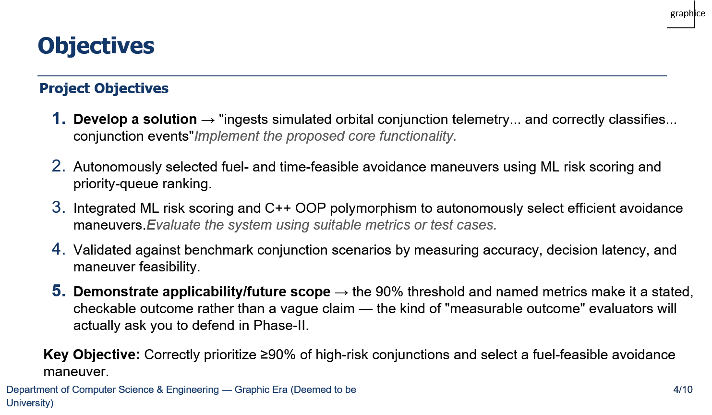

Slide 5
Proposed Solution
Proposed Approach
Input-Collect conjunction telemetry including Object ID, Miss Distance, TCA, Relative Velocity, Required ΔV, and Collision Probability, along with spacecraft mass and available fuel.
Processing-Process telemetry using Queue and Circular Queue, apply Logistic Regression for risk assessment, and use a Priority Queue to rank threats.
System Logic-Identify the highest-risk threat, evaluate Chemical, Ion, and Cold-Gas thrusters, and check ΔV, thrust,Burn time,and fuel before selecting a feasible maneuver.
Database-C structures store incoming telemetry records; Queue and Circular Queue manage telemetry, Priority Queue prioritizes threats, Array stores thruster information, Stack tracks recent maneuvers, and Linked List maintains complete maneuver history and a log file for system activities.
Output -Display the predicted risk level, threat priority, selected thruster, fuel status, burn duration, and final maneuver decision.
Key Features
ML-based multi-factor risk assessment
Risk-based threat prioritization
Autonomous thruster selection
Fuel & burn-time feasibility checks
Maneuver history and logging
The system uses ML and custom Data Structures to accurately assess and prioritize collision threats.OOP-based thruster selection with fuel and time checks ensures feasible and safe avoidance maneuvers.

Slide 6
Integration of PBL Course Concepts
Course | Concepts Applied | Project Module
Data Structures in C | Structures, Arrays, Queue, Circular Queue, Priority Queue, Stack, Linked List . | 1.Orbital Telemetry Management 2.Threat Prioritization 3.Maneuver History Management
OOPs with C++ | Classes, Encapsulation, Abstraction, Inheritance, Polymorphism, Exception Handling | 1.Thruster Engine Management 2.Autonomous Thruster Dispatch 3.Collision Avoidance Maneuver Control
Requirement:Both subjects are integrated to manage orbital telemetry, prioritize collision threats, and select feasible thrusters for avoidance maneuvers.

Slide 7

System Architecture / Workflow
graphice
Input Data:
Raw Spacecraft Telemetry & Space-Track CDMs
Processing Layer:
Circular Queue & FIFO Ingestion Layer
Core Logic:
ML Risk Scoring & Binary Max-Heap Priority
Database Layer:
Stack, Linked List & Append Log
Output Result:
Burn Vector, Fuel Sync & Audit Trail
Major Components
Telemetry Ingestion (C): Circular ring buffer and FIFO queue for zero-heap, deterministic data buffering.
Risk & Priority Engine: In-place Logistic Regression risk scoring paired with a Binary Max-Heap to prioritize critical threats.
Polymorphic Thrusters (C++): OOP ThrusterEngine interface arbitrating Chemical, Ion, and Cold-Gas systems via the rocket equation.
Audit & Rollback: LIFO stack for quick undos, doubly linked list for chronological history, and an append-only log file.
Data / Control Flow
How data moves: Telemetry and CDMs enter C queues, feed the Logistic Regression model for risk scoring, and rank into the Max-Heap.
How modules interact: The heap feeds the highest threat to the C++ dispatcher, which checks burn time and fuel limits before triggering an engine fallback.
Expected output: Deterministic burn command, updated fuel mass, and an immutable log entry.

Slide 8
Technology Stack & Methodology
graphice
Technology Stack
Development Methodology
Programming: C/C++
Database:In-Memory Data Structures
Tools / Framework: Scikit-learn, CMake, GCC
IDE: Visual Studio Code
Version Control:Git & GitHub
Requirement Analysis: Defined collision alert inputs and response timing needs
System Design: Planned memory queues, threat scoring, and thruster logic
Implementation: Wrote core C buffers, ML classifier, and C++ engine controllers
Testing: Tested with simulated close-approach data and thruster failures
Evaluation: Verified decision speed, memory stability, and maneuver validity.
Technology Justification
In-Memory Structures: Replaces SQL to bypass disk latency and overhead, utilizing O(1)/O(log n) CPU cache access.
Edge ML: Performs local risk assessment d~miss, v~rel, t~TCA, σ to eliminate communication delays.GCC & CMake: Provides industry-standard, cross-compilation with strict compile-time error checking.
Methodology Justification
Sequential Stage-Gate Flow: Validates physics modeling and requirements before implementation, ensuring aerospace safety standards.
Fault-Injection Testing: Ensures resilience against critical failure modes, including telemetry overflow and thruster issues.

Slide 9
Initial Progress & Team Contribution
graphice
Progress Achieved
Background / literature study: Reviewed CCSDS CDM formats and LEO conjunction dynamics
Requirements identified: Established real-time reaction constraints and fixed-memory design
Architecture prepared: Mapped complete 5-stage pipeline from C queues to C++ dispatch
Initial module implemented: Scaffolding complete; built terminal prototype via single-file runner
Data preparation: Preprocessed benchmark LEO conjunction data and CDM alerts from Space-Track and CelesTrak.
Individual Contribution
Member | Role | Contribution
Adamya Rawat | Lead | System architecture design, module pipeline flow, and overall coordination
Atiksh Sharma | Developer | Backend Architecture Design,Data Structure, Requirements and implementation
Agamya Saini | Research/Testing | Research coordination & problem analysis ,Finding Current Gaps.
Krishna Sehgal | Developer/Docs | Literature review, CDM data collection, and technical documentation

Slide 10
Roadmap, Expected Outcomes & References
graphice
Roadmap
Phase-I: System Design & Ingestion: Finalize zero-allocation C queue architectures and mathematical encounter models.
Phase-II: Core Engine & ML Integration: Build the edge logistic regression classifier, binary max-heap, and C++ propulsion dispatcher.
Phase-III: Validation & Benchmarking: Conduct fault-injection testing, thruster fallback simulations, and execution latency audits.
Expected Outcomes
  Working System: Zero-heap C/C++ engine handling concurrent alerts
  Measurable Results: Sub-millisecond threat ranking & fast ΔV calculation
  Practical Applicability: Safe autonomous fallback during thruster failures
  Future Scalability: Portable codebase ready for ARM embedded
References
Standard: CCSDS 508.0-B-1 Conjunction Data Message (CDM) Standard
Safety Standard: MISRA C:2012 Guidelines for Critical Systems
Documentation: ISO/IEC C++17 Standards & GCC Toolchain Manuals
Dataset: CelesTrak & Space-Track Ephemeris / Conjunction Archives
Thank You
Questions & Suggestions

